Slide 1
Yapay Sinir Ağı Nedir?

Slide 2
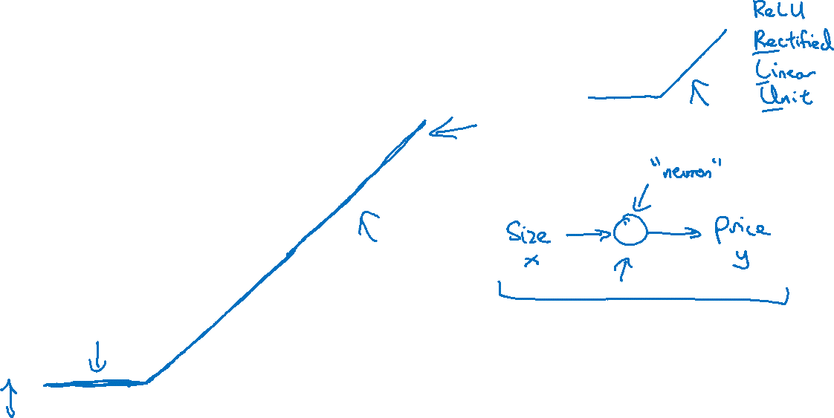
Housing Price Prediction
price
size of house

Slide 3
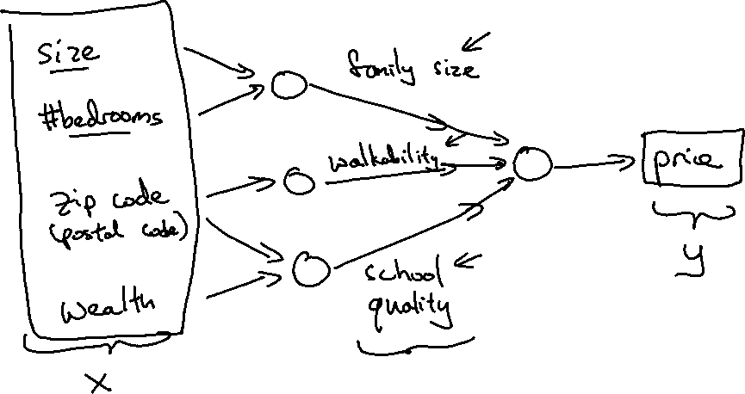
Housing Price Prediction

Slide 4
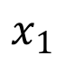
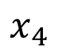
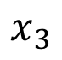
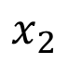
Housing Price Prediction
size
$$x_{1}$$
#bedrooms
$$x_{2}$$
y
zip code
$$x_{3}$$
wealth
$$x_{4}$$

Slide 5
Supervised Learning
Input(x)
Output (y)
Application
Home features
Price
Real Estate
Ad, user info
Click on ad? (0/1)
Online Advertising
Image
Object (1,…,1000)
Photo tagging
Audio
Text transcript
Speech recognition
English
Chinese
Machine translation
Image, Radar info
Position of other cars
Autonomous driving

Slide 6
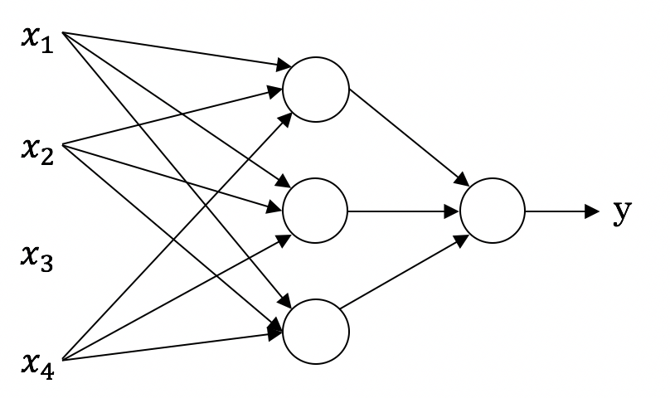
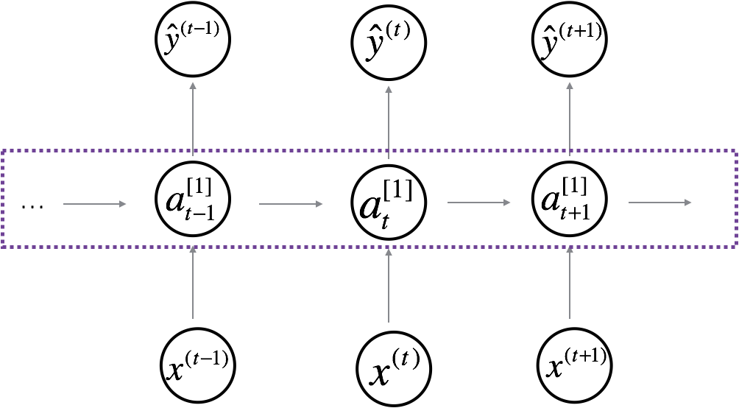
Neural Network examples
Standard NN
Convolutional NN
Recurrent NN

Slide 7

Supervised Learning
Structured Data
Unstructured Data
Size | #bedrooms | … | Price (1000$s)
2104 1600 2400 ⋮ 3000 | 3 3 3 ⋮ 4 |  | 400 330 369 ⋮ 540
Audio
Image
User Age | Ad Id | … | Click
41 80 18 ⋮ 27 | 93242 93287 87312 ⋮ 71244 |  | 1 0 1 ⋮ 1
Four scores and seven years ago…
Text

Slide 8
Derin Öğrenme neden gelişiyor?

Slide 9
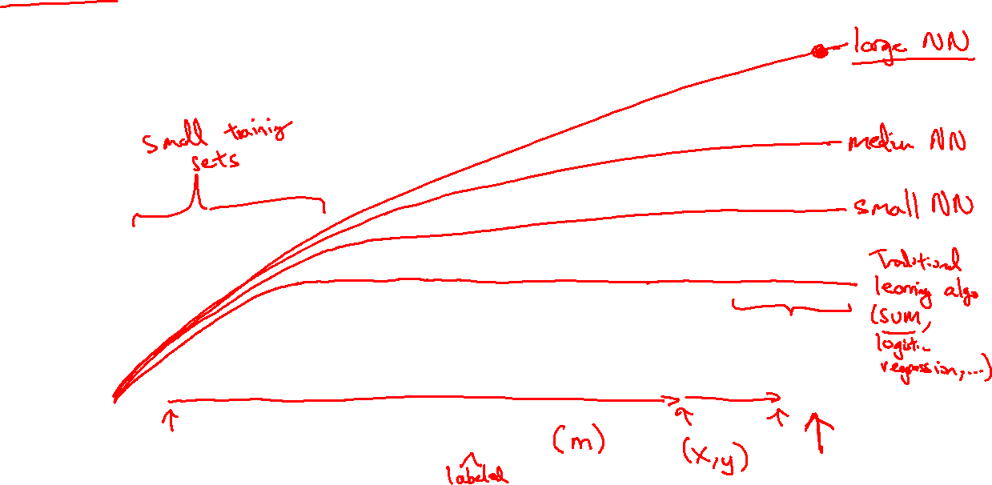
Scale drives deep learning progress
Performance
Amount of data

Slide 10

Scale drives deep learning progress
Idea
Data
Computation
Algorithms
Experiment
Code

Slide 11
Hesaplama Grafiği

Slide 12
Computation Graph

Slide 13
Computing derivatives
$$a=5$$
11
33
$$b=3$$
6
$$v=a+u$$
$J=3v$
$u$=$bc$
$$c=2$$

Slide 14
Lojistik Regresyon Gradyan inişi

Slide 15
Logistic regression recap
$$z= w^{T}x+b$$
$$\hat{y}=a= σ(z)$$
$$ℒ\left(a,y\right)=−(y\log{(a)+(1−y)\log{(1−a))}}$$

Slide 16
Logistic regression derivatives
$$x_{1}$$
$$w_{1}$$
$$x_{2}$$
$$z= w_{1}x_{1}+w_{2}x_{2}+b$$
$$a= σ(z)$$
$$ℒ(a,y)$$
$$w_{2}$$
b

Slide 17
Sinir Ağı Temsili

Slide 18
What is a Neural Network?
$$x_{1}$$
$$x_{2}$$
$$\hat{y}$$
$$x_{3}$$
x
w
$$z=w^{T}x+b$$
$$a=σ(z)$$
$$ℒ(a,y)$$
b
$$x_{1}$$
$$x_{2}$$
$$\hat{y}$$
$$x_{3}$$
x
$$W^{[1]}$$
$$z^{[1]}=W^{[1]}x+b^{[1]}$$
$$a^{[1]}=σ(z^{[1]})$$
$$z^{[2]}=W^{[2]}a_{ }^{[1]}+b^{[2]}$$
$$a^{[2]}=σ(z^{[2]})$$
$$ℒ(a^{[2]},y)$$
$$b^{[1]}$$
$$W^{[2]}$$
$$b^{[2]}$$

Slide 19
Neural Network Representation
$$x_{1}$$
$$x_{2}$$
$$\hat{y}$$
$$x_{3}$$

Slide 20
Neural Network Representation
$$x_{1}$$
$$x_{1}$$
$$x_{2}$$
$$σ(z)$$
$$a=\hat{y}$$
$$x_{2}$$
$$\hat{y}$$
$$w^{T}x+b$$
$$z$$
$$a$$
$$x_{3}$$
$$x_{3}$$
$$z=w^{T}x+b$$
$$a=σ(z)$$

Slide 21
Neural Network Representation
$$x_{1}$$
$$x_{1}$$
$$x_{2}$$
$$σ(z)$$
$$a=\hat{y}$$
$$x_{2}$$
$$\hat{y}$$
$$w^{T}x+b$$
$$z$$
$$a$$
$$x_{3}$$
$$x_{3}$$
$$z=w^{T}x+b$$
$$x_{1}$$
$$a=σ(z)$$
$$x_{2}$$
$$\hat{y}$$
$$x_{3}$$

Slide 22
Neural Network Representation
$$a_{1}^{\left[1\right]}$$
$z_{1}^{\left[1\right]}=w_{1}^{{\left[1\right]T}^{ }}x+b_{1}^{[1]}, a_{ 1}^{[1]}=σ(z_{1}^{\left[1\right]}$)
$$x_{1}$$
$$a_{2}^{\left[1\right]}$$
$z_{2}^{\left[1\right]}=w_{2}^{{\left[1\right]T}^{ }}x+b_{2}^{[1]}, a_{ 2}^{[1]}=σ(z_{2}^{\left[1\right]}$)
$$x_{2}$$
$$\hat{y}$$
$$a_{3}^{\left[1\right]}$$
$z_{3}^{\left[1\right]}=w_{3}^{{\left[1\right]T}^{ }}x+b_{3}^{[1]}, a_{ 3}^{[1]}=σ(z_{3}^{\left[1\right]}$)
$$x_{3}$$
$$a_{4}^{\left[1\right]}$$
$z_{4}^{\left[1\right]}=w_{4}^{{\left[1\right]T}^{ }}x+b_{4}^{[1]}, a_{ 4}^{[1]}=σ(z_{4}^{\left[1\right]}$)

Slide 23
Aktivasyon fonksiyonları

Slide 24
Activation functions
$$x_{1}$$
$$x_{2}$$
$$\hat{y}$$
$$x_{3}$$
Given x:
$$z^{\left[1\right]}=W^{\left[1\right]}x+b^{\left[1\right]}$$
$$a^{\left[1\right]}=σ(z^{\left[1\right]})$$
$$z^{\left[2\right]}=W^{\left[2\right]}a^{\left[1\right]}+b^{\left[2\right]}$$
$$a^{\left[2\right]}=σ(z^{\left[2\right]})$$

Slide 25
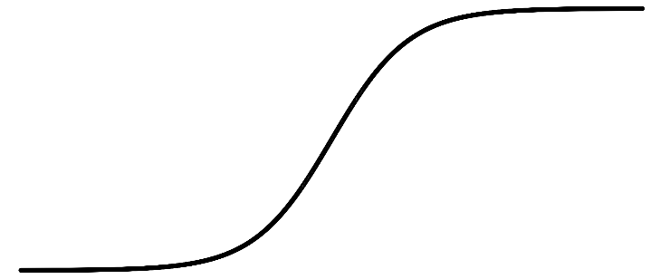
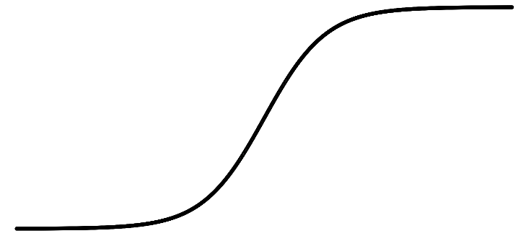
Activation functions
a
a
x
z
$$a= \frac{1}{1+e^{−z}}$$
sigmoid:
a
a
z
z

Slide 26
Geri yayılım

Slide 27
Computing gradients
Logistic regression
$$x$$
$$w$$
$$z=w^{T}x+b$$
$$a= σ(z)$$
$$ℒ(a,y)$$
$$b$$

Slide 28
Gradient descent for neural networks

Slide 29
Neden derin öğrenme?

Slide 30

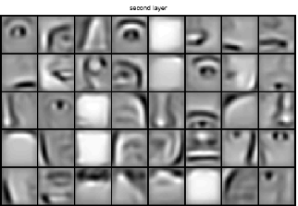
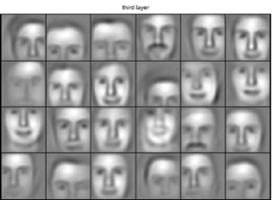
Intuition about deep representation
$$\hat{y}$$

